Slide 1

Investment Management System
Presented By-
Prathamesh Nemade (002139730)
Urvang Patel (001568243)
Ronak Patil (001007035)

Slide 2
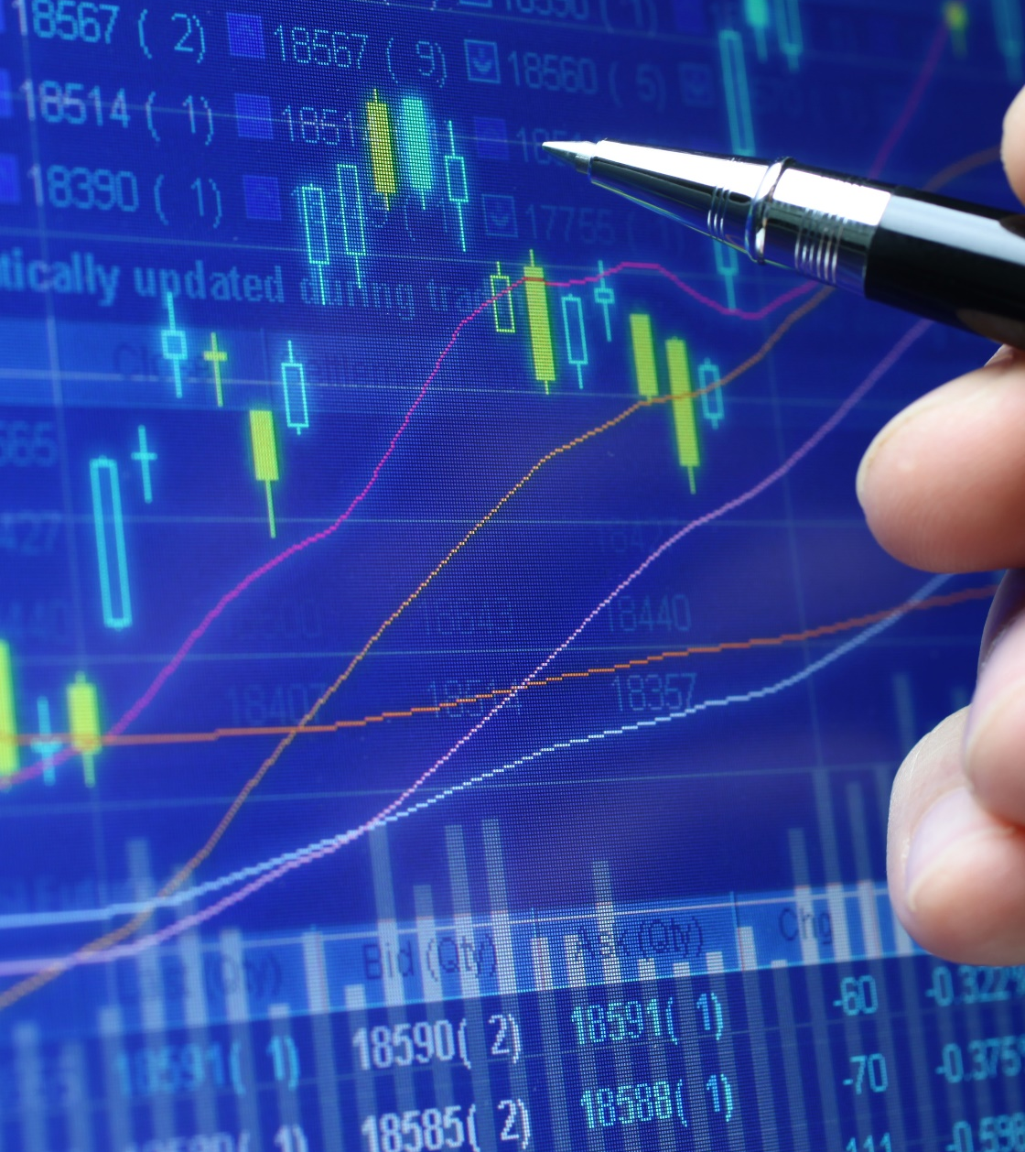
Ecosystem
Our ecosystem's goal is to give consumers with a unified investing platform where they can keep track of all their assets and activities. Keeping track of several sorts of investments might be difficult or confusing at times. With the aid of our ecosystem, customers will be able to conveniently manage and track all of their assets. Our primary goal is to create a flexible investment management software that will encourage individuals to invest wisely from their money for a brighter future.

Slide 3
Problem Statement
Anxiety, uncertainty, turbulence, and financial troubles marked the year 2020. For good reason, individuals who work in the stock market were extremely worried. The coronavirus-caused stock market crash of 2020 was a big and unexpected global event that began on February 20th, 2020 and finished on April 7th, 2020.
As the epidemic spread in March and governments throughout the world shut down economic activity, panic fueled by the economic ramifications and uncertainty resulted in a stock market crash.
Customers should be prepared with their investing strategy in case of such unexpected events.

Slide 4
Solution
We created a system that allows customers to quickly track all of their assets across various investment sectors and make investing actions simple even for first-time users. We believe that the investing system should be intended to benefit everyone. As a result, we provide products that allow you to start investing at your own pace and on your own terms.

Slide 5
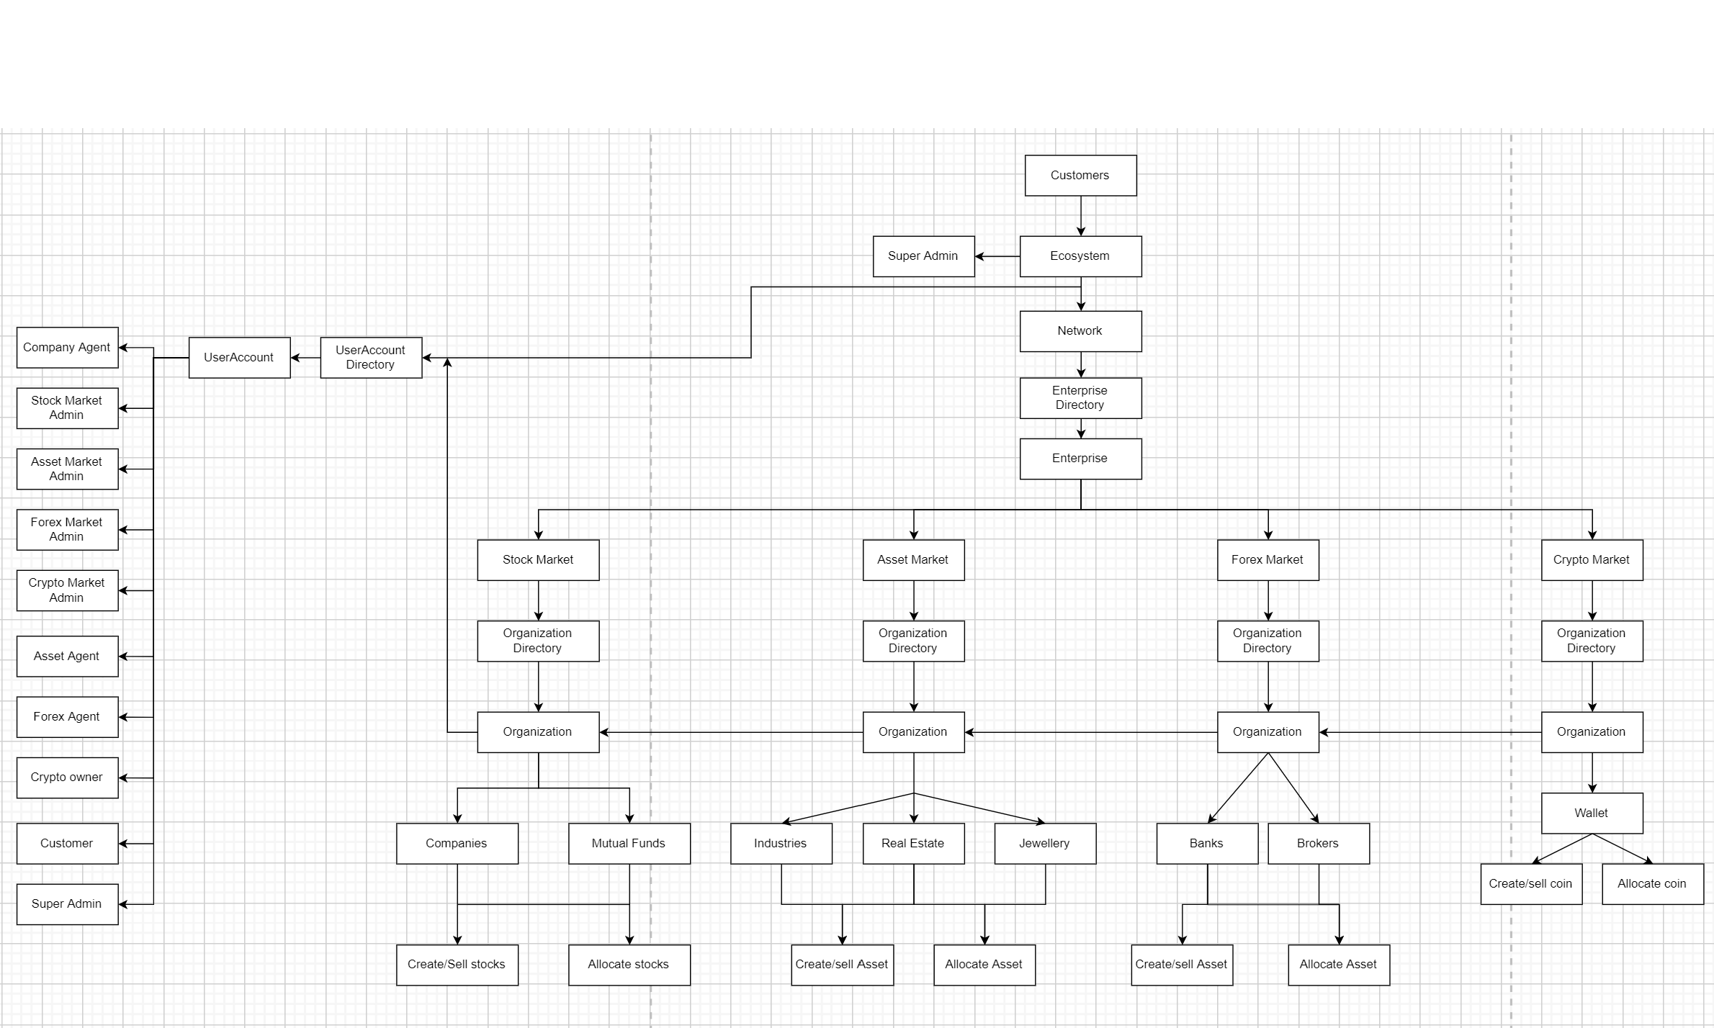
Flow diagram

Slide 6
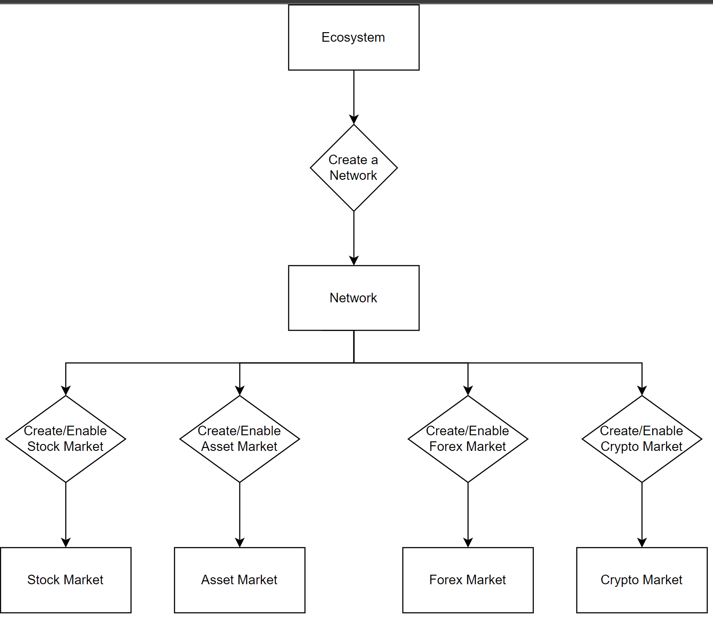
Super admin

Slide 7
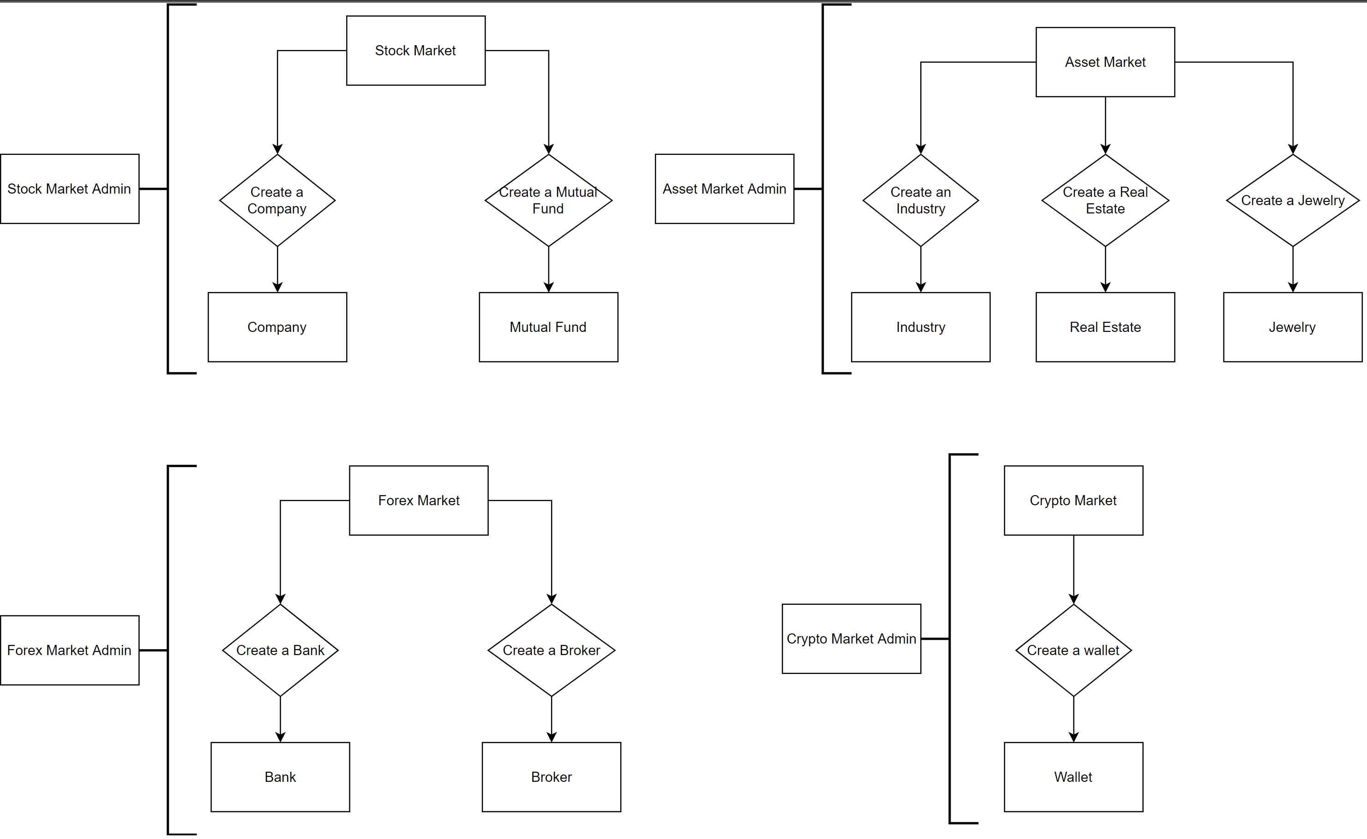
enterprise

Slide 8
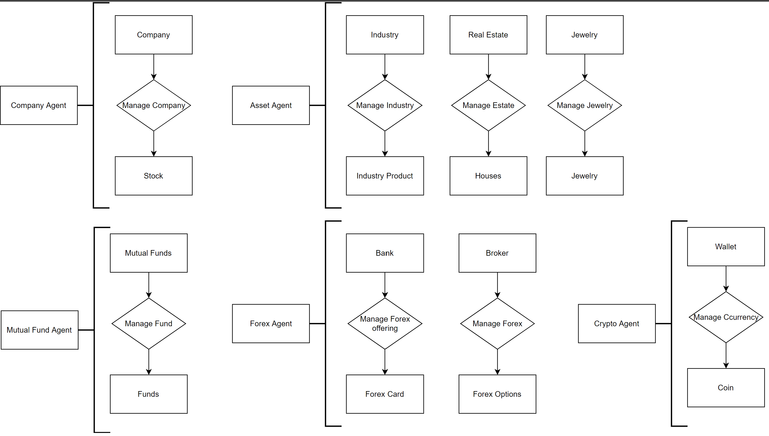
organization

Slide 9
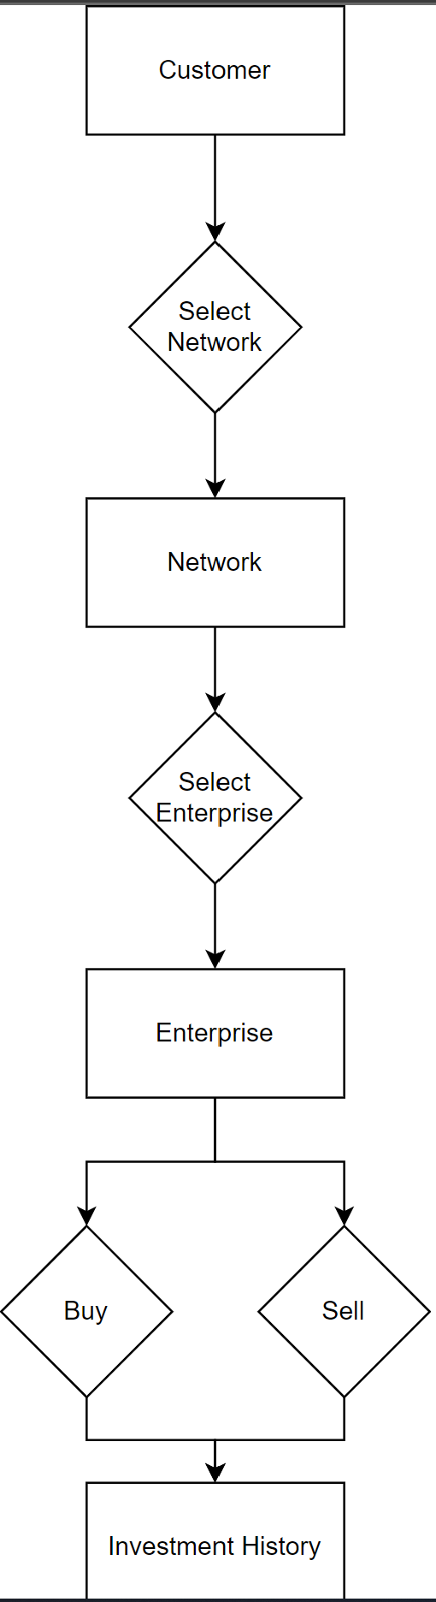
customer

Slide 10
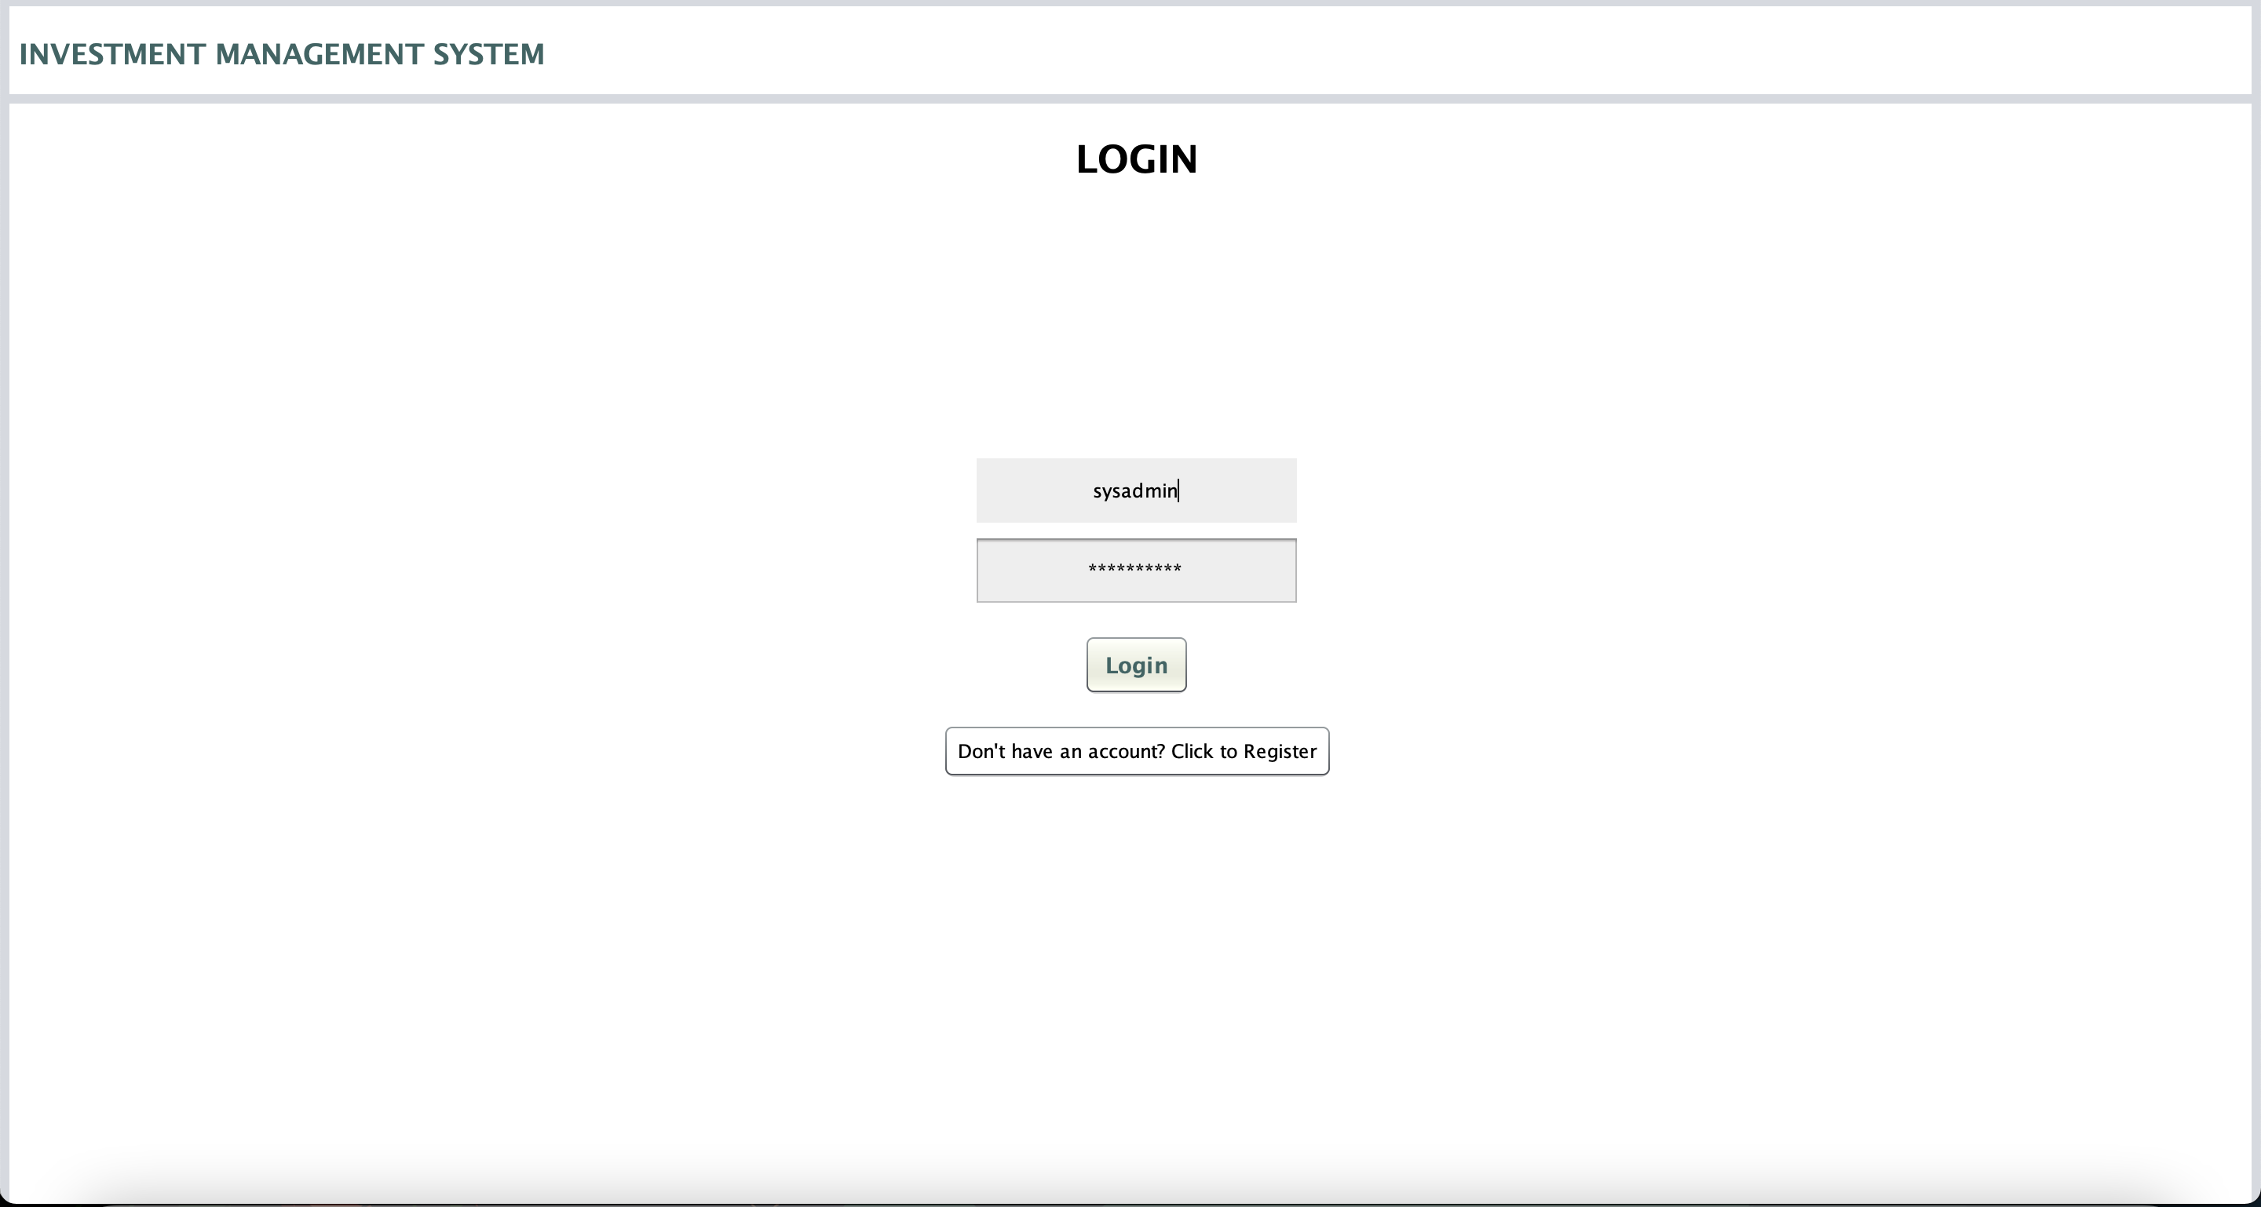
Login Page

Slide 11
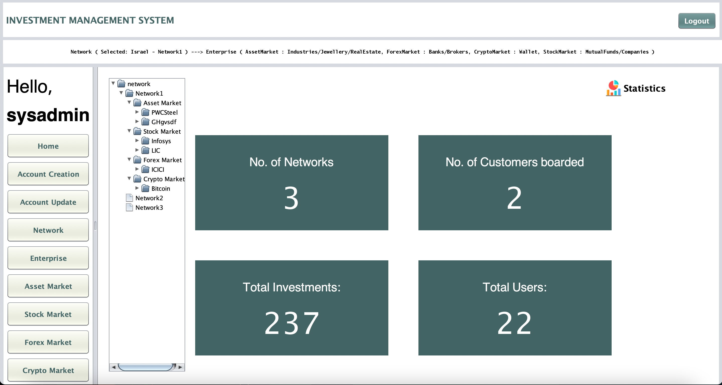
System admin

Slide 12
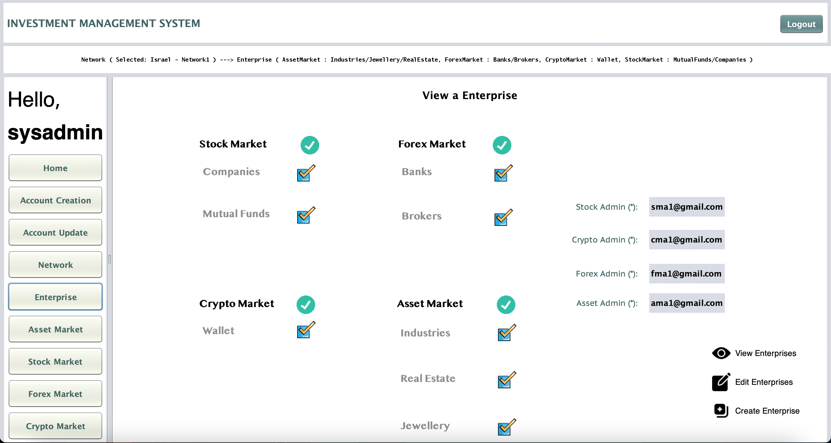
Enterprise

Slide 13
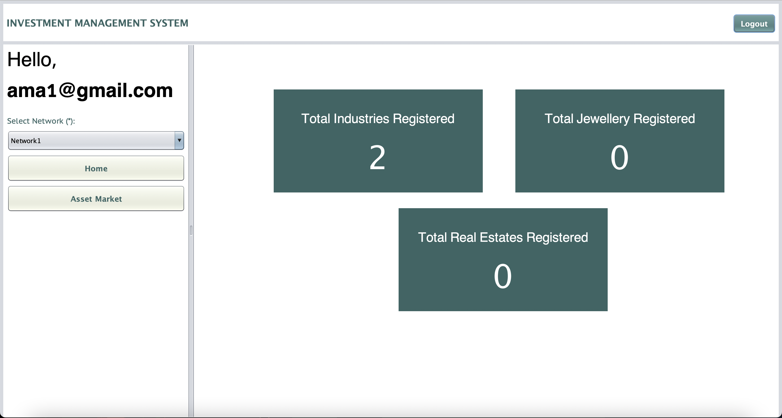
Admin

Slide 14
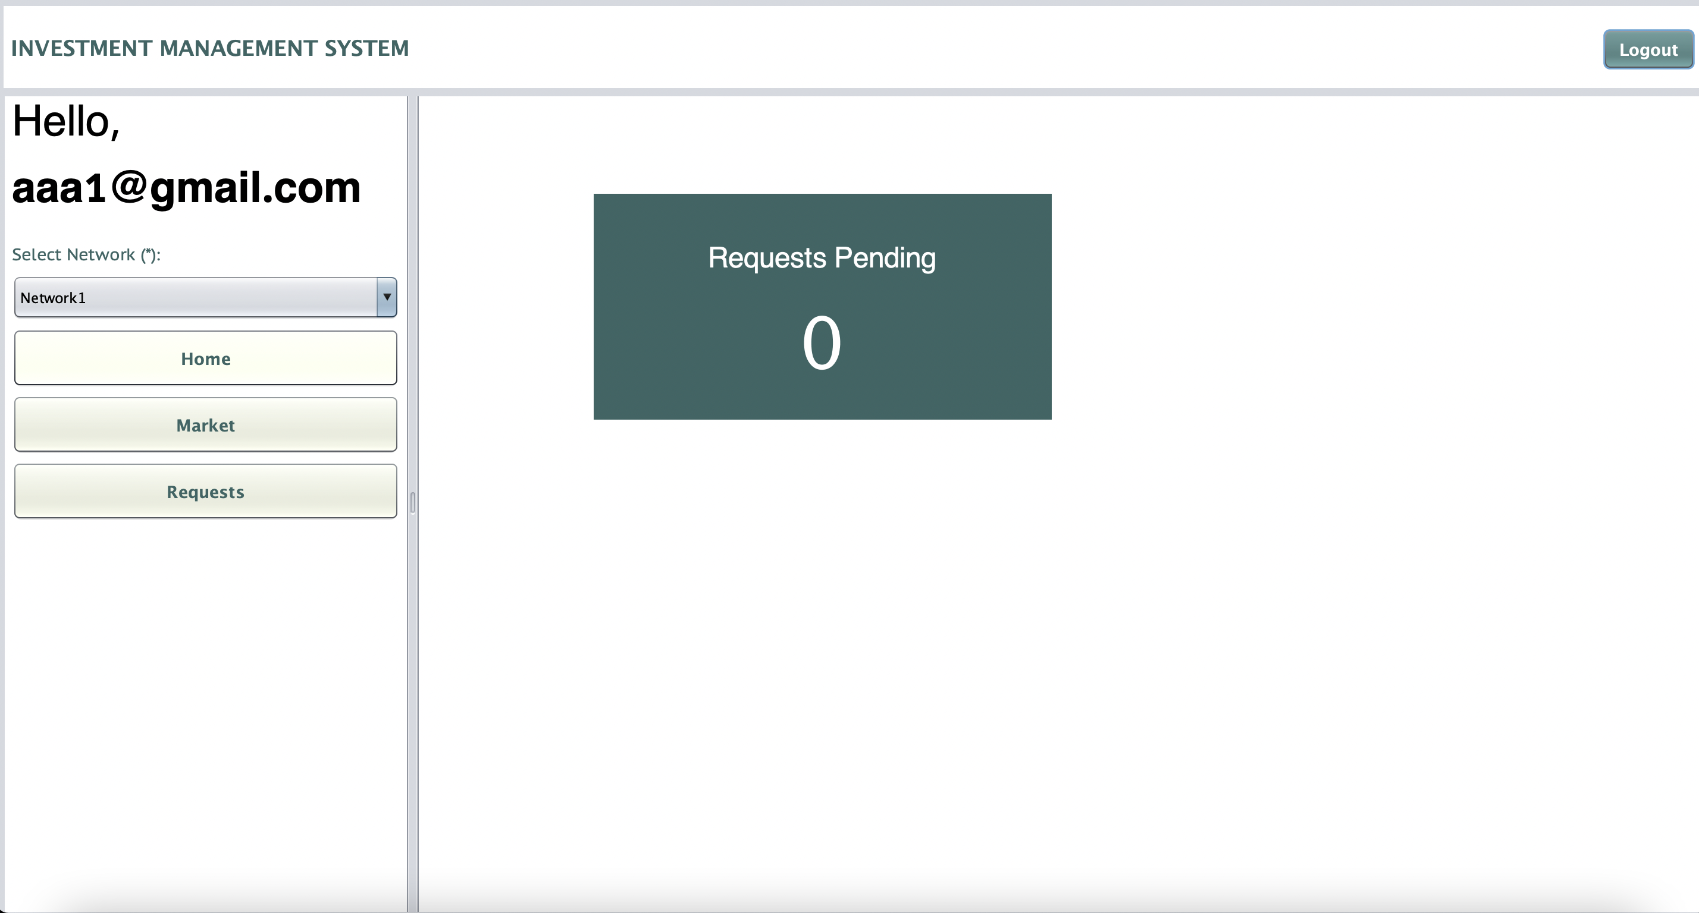
agent

Slide 15
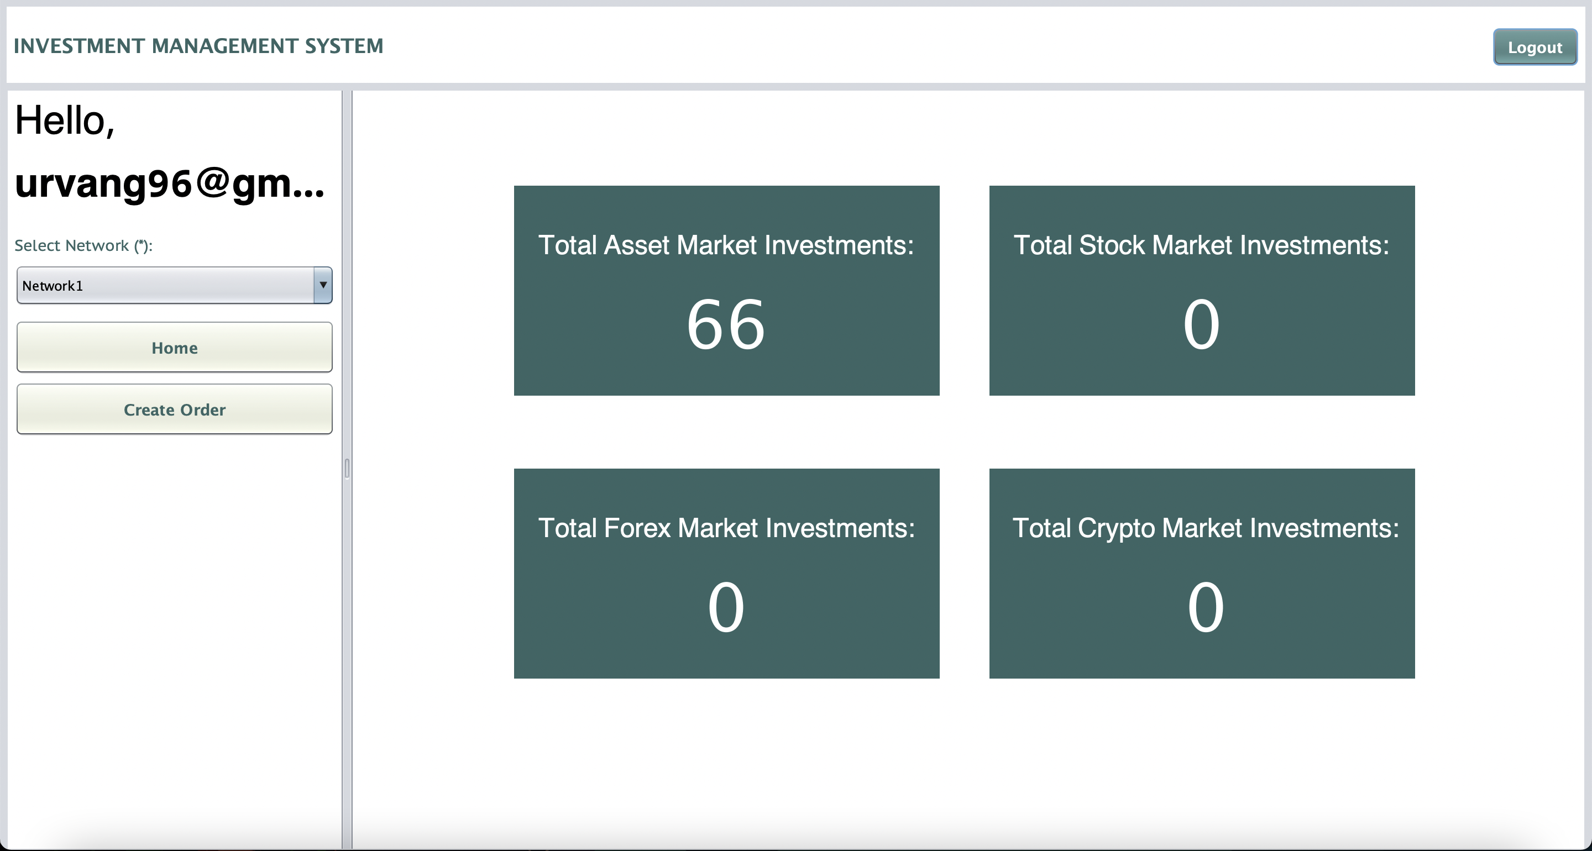
customer

Slide 16
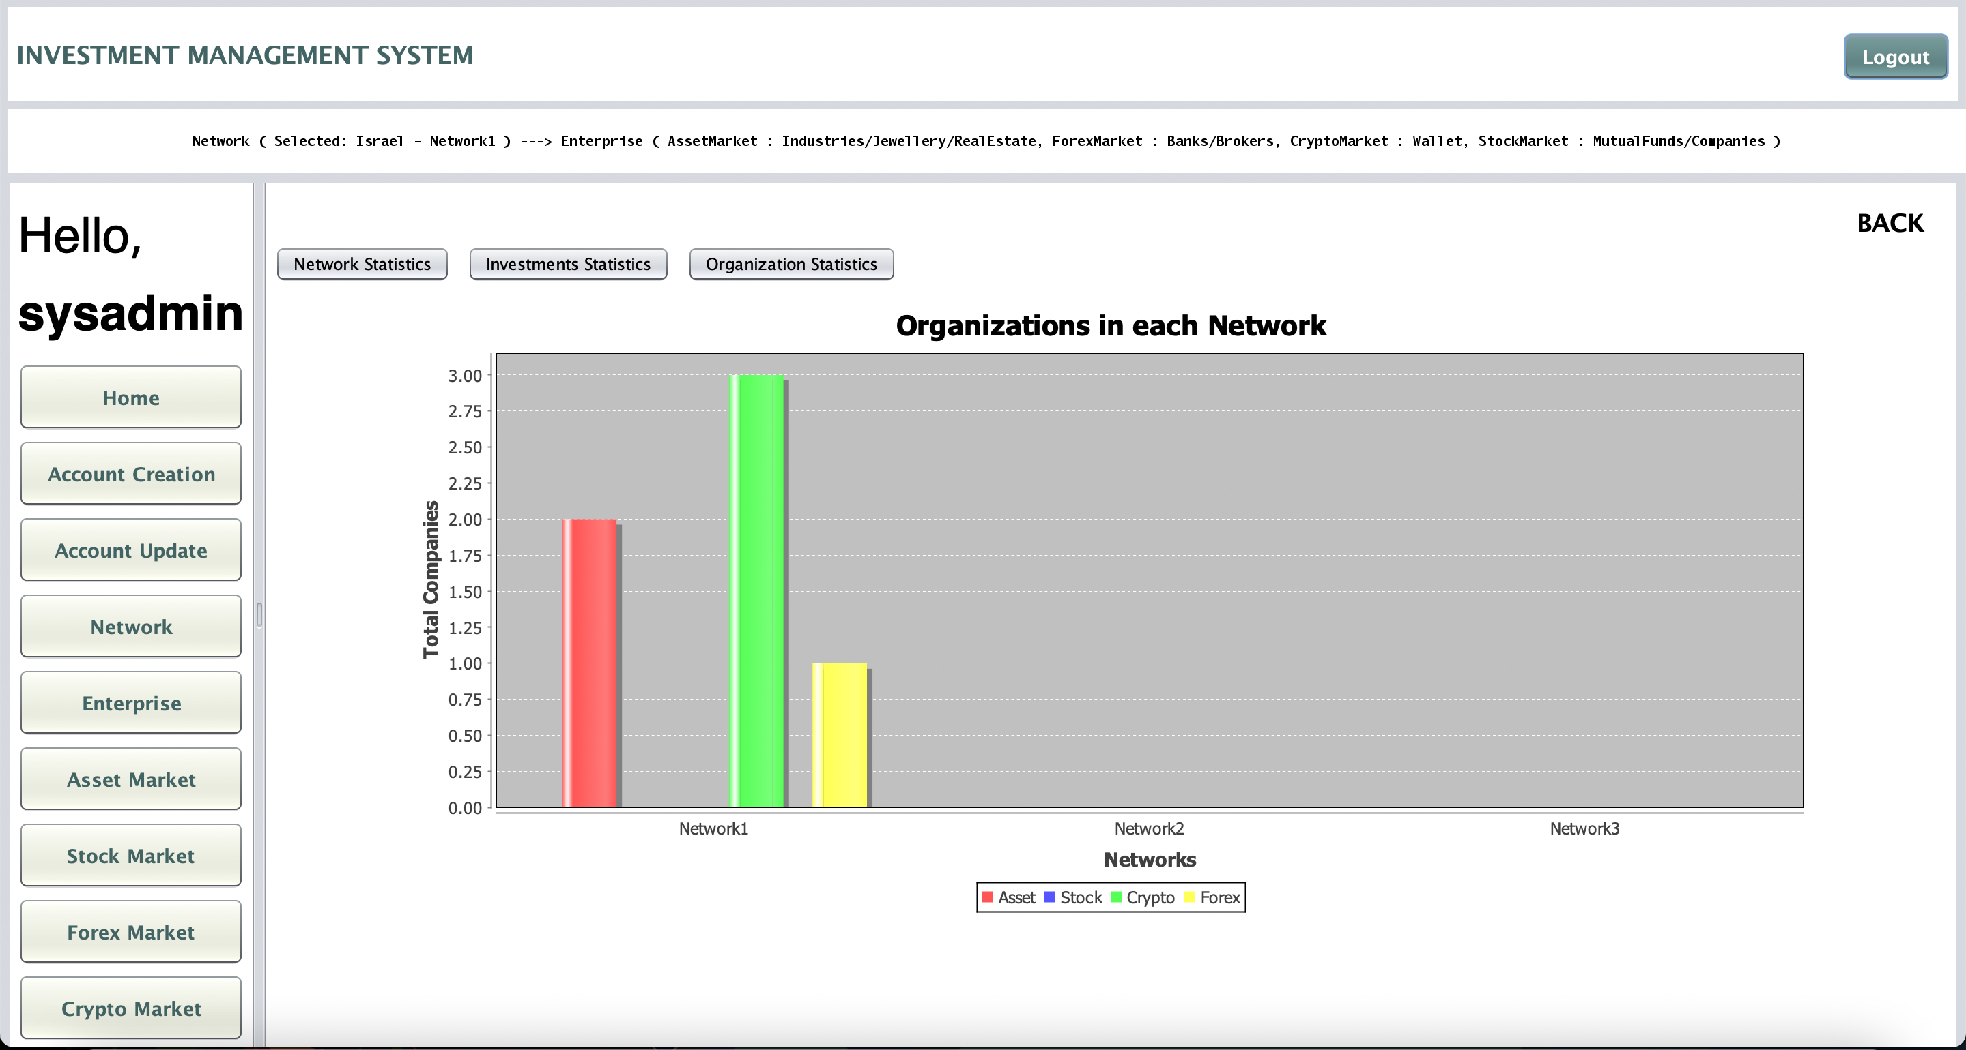
Statistics

Slide 17
Thank you
Presented By-
Prathamesh Nemade (002139730)
Urvang Patel (001568243)
Ronak Patil (001007035)

